Slide 1
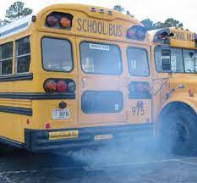
NYS Anti-idling Regulations
Notes:
Instructor Notes:
Let’s review the New York State anti-idling regulations that impact the job you do as school bus drivers.

Slide 2
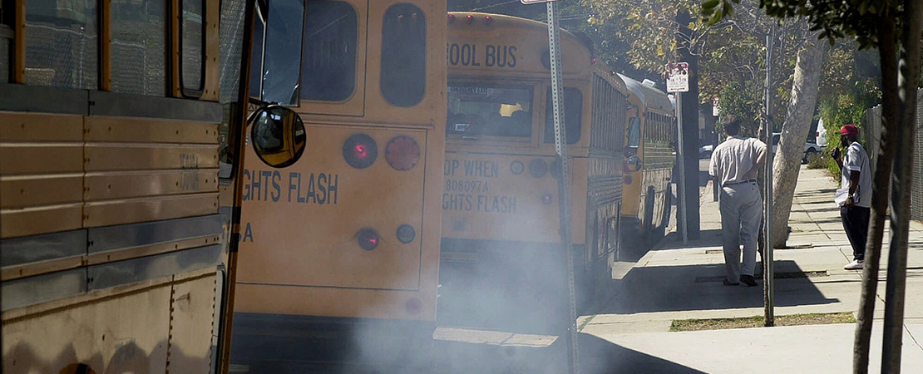
Overview
Effects of unnecessary idling
Understanding challenges related to idling
Strategies to decrease idling
Notes:
Instructors Notes:
Go over each bullet on the slide with participants.
Discussion Points:
Overview:
The discussion today will focus on three areas.
First, we will discuss the effects of unnecessary idling of your school bus.
Next, to better understand the issues of idling, we will review the challenges related to it.
And last, we will identify strategies to decrease the idling of our school buses.

Slide 3
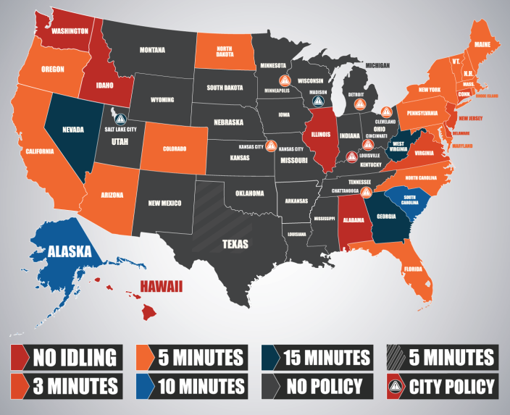
Anti-idling
Many states have laws that regulate engine idling
Regulate vehicle types
Regulate idling geographically
Regulate by time limits
Details for each of the states can be found on the US Department of Energy’s Alternative Fuels Data Center Federal and State Laws and Incentives page.
Notes:
Instructors Notes:
Go over each bullet on the slide with participants.
Discussion Points:
Thirty states and the District of Columbia have laws regulating engine idling, but each has different applications of idle reduction and various exemptions.
Some states regulate only certain vehicle types, such as school buses, state vehicles, commercial vehicles, diesel vehicles, or vehicles over a certain weight rating.
Some states regulate idling geographically, such as on school property, in business districts, or in certain counties.
Other states have time limits on how long an engine may be idled or idle limits during certain times of the year.
Details for each state can be found on the US Department of Energy’s Alternative Fuels Data Center Federal and State Laws and Incentives page.
For this section, we will concentrate on New York State anti-idling regulations.

Slide 4
Anti-idling Fines
Fines can range from $350 to as much as $2,000
Notes:
Instructors Notes:
Emphasize the consequences for non-compliance. By using the points below.
Discussion Points:
The Department of Environmental Protection enforces the idling law.
Fines range from 350 dollars to 2,000 dollars.
Under New York State law, heavy-duty diesel trucks and buses may not idle for more than five minutes in a row unless the temperature is less than twenty-five degrees Fahrenheit.

Slide 5
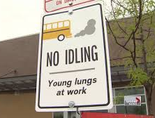
N.Y.S. Anti-idling Law & Regulation
Chapter 670 Law of 2007 bans idling on or adjacent to school grounds
8 NYCRR 156.3 (h) establishes school district responsibility and bus driver requirements
Notes:
Instructors Notes:
Cover the details of regulatory compliance using the points provided.
Discussion Points:
There are several laws governing the idling of school buses, including Chapter 670 Law of 2,007,
Diesel or non-diesel-powered, heavy-duty vehicles designed primarily to transport persons or property can idle a maximum of five minutes in New York State.
New York City reduces that limit to three minutes or one minute if the vehicle is adjacent to a school. Several counties have their own local regulations.
School districts have the responsibility for anti-idling.

Slide 6
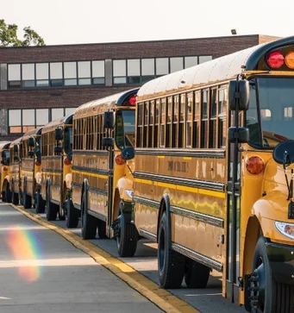
Education Law section 3637
Requires School Districts To:
Minimize school bus idling
Shut off engines while waiting for passengers to load
Apply law to all school vehicles
Owned, leased, or contracted
While parked or standing on school grounds or in front of any school
Annually provide notice to employees
Notes:
Instructors Notes:
Engage participants using the points below.
Discussion Points:
Education Law section 3637 requires school districts to minimize school bus idling by shutting off engines while waiting for passengers to load.
This applies to all school vehicles owned, leased, or contracted, parked or standing on school grounds or in front of any school.
This law also requires annual notice to employees regarding these restrictions.

Slide 7
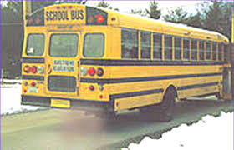
Regulations Similar to 8 NYCRR 156.3 (h)
Requires School Districts & Drivers To:
Shut off engines while waiting for students to load:
Applies to vehicles owned, leased, or contracted
While parked or standing on school grounds or in front of any school
Exceptions for safety, emergency, and mechanical work
Conduct semi-annual compliance monitoring
Notes:
Instructors Notes:
Share with drivers this additional information regarding the regulatory obligation of school districts and drivers using these points.
Discussion Points:
Education Law 156.3, similar to section 3637, requires school districts & drivers: to shut off vehicle engines while waiting for students to load.
This applies to owned, leased, or contracted vehicles while parked or standing on school grounds or in front of any school.
Section 156.3 goes on to require semi-annual monitoring of driver compliance. There are exceptions for safety, emergency, and mechanical work.

Slide 8
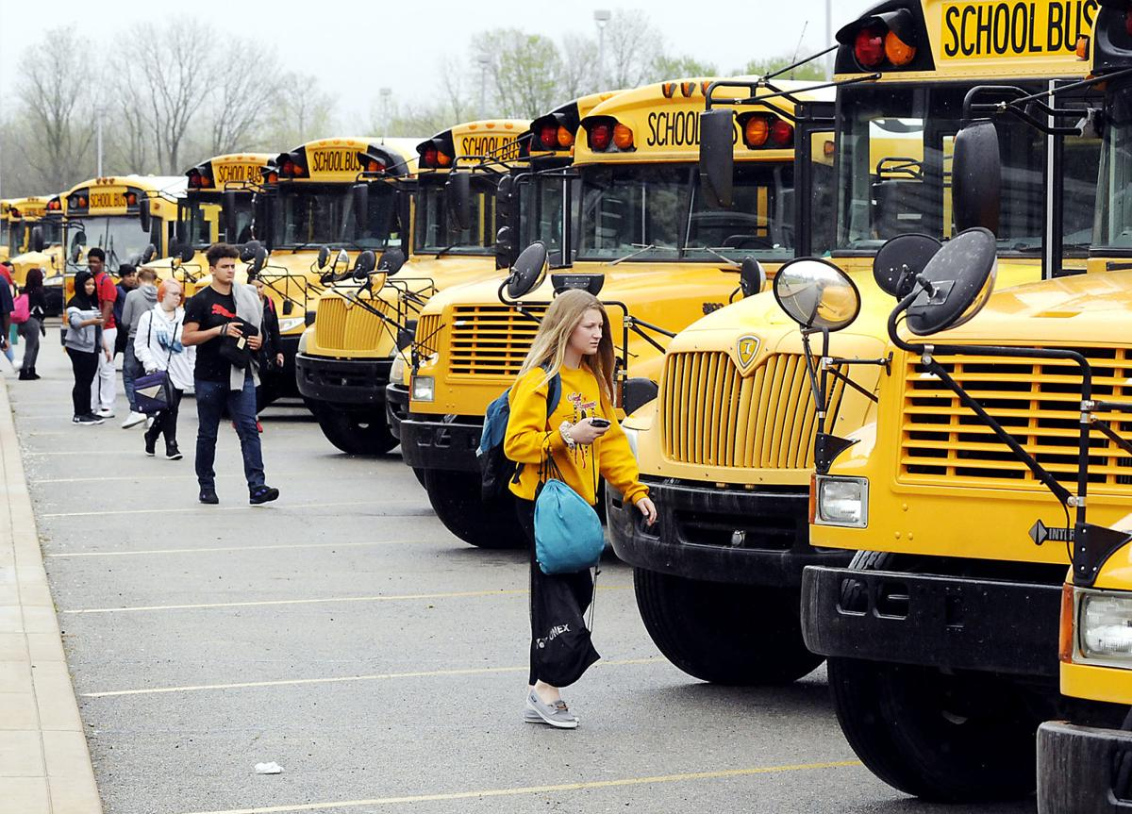
Driver Responsibilities
Law & Regulations Require School Bus Drivers To:
Limit idling time during warm-up
2. Park away from building fresh air intakes
3. Park diagonally in school loading areas whenever possible
4. Instruct students to board the bus promptly
5. Turn the bus off during sporting or other events
Notes:
Instructors Notes:
This slide provides guidance for drivers regarding compliance of anti-idling laws.
Engage in a discussion using the points below.
Discussion Points:
Laws & Regulations Require School Bus Drivers to limit idling time during warm-up, park away from building fresh air intakes, park diagonally in school loading areas whenever possible to minimize the amount of exhaust from adjacent buses that may enter other school buses in the loading zone and school buildings .
In addition, drivers must instruct students to board the bus promptly in the afternoon to reduce loading time.
Drivers must turn the bus off during sporting or other events to minimize the amount of exhaust from adjacent buses that may enter the school bus and school buildings where applicable.

Slide 9
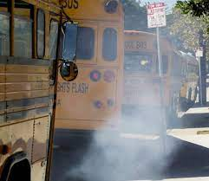
The Health Dangers of Idling
Cancer-causing substances
Particulate matter, which exacerbates respiratory conditions
Increases the amount of exhaust entering a bus
Children are especially susceptible
Students walking by idling buses inhale large amounts of diesel exhaust
Idling under fresh air intakes at schools causes exhaust to enter building
Notes:
Instructors Notes:
Ask participants what the health dangers are there in idling.
Write their answers down on a flip chart.
Then reveal the 6 bullets on the slide.
Facilitate a discussion using the points below.
Discussion Points:
There are identifiable health dangers of excessive engine idling.
Diesel exhaust contains cancer-causing substances and particulate matter, which exacerbates respiratory conditions.
Idling increases the amount of diesel exhaust which may enter a bus through open windows or loose door seals.
Children are especially susceptible to diesel exhaust.
Students walking by idling buses inhale large amounts of diesel exhaust.
Idling under fresh air intakes at schools causes diesel exhaust to be drawn into the building.

Slide 10
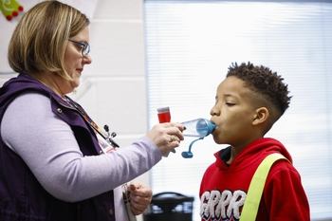
The Impact on Children
Kids respiratory systems are still developing; they breathe faster taking in more air.
Diesel exhaust has billions of small particles that become lodged in their lungs
Can cause lung damage, aggravate asthma, bronchitis and other health problems.
Notes:
Instructors Notes:
Remind drivers that we are in the business of keeping children safe.
This is true not only out on the road but when stopped too.
Engage the participants in a discussion using the points provided.
Discussion Points:
Children are especially vulnerable to air pollution because their lungs are still in the developmental phase and they breathe, on average, 50 percent more air per pound of body
weight than adults.
School children who ride on older diesel school buses that lack pollution controls have a 4% increased likelihood of developing cancer due to diesel particulate matter in their lifetime.
In addition, exposure to diesel exhaust enhances allergic response, can induce new allergies to airborne allergens, and exacerbate asthma.
Studies have also shown that diesel exhaust gets caught in the school bus cabin, increasing children’s exposure.
Although bus commutes only comprise a fraction of a child’s day, the bus ride can represent up to 1/3 of child’s daily diesel pollution exposure.

Slide 11
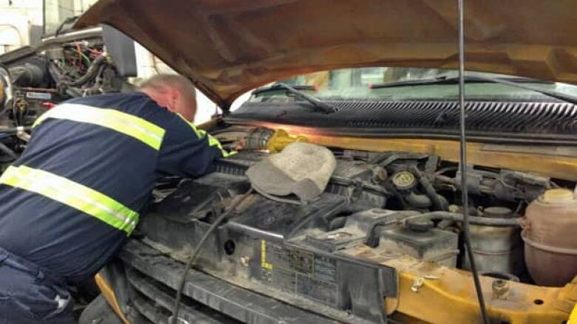
Exceptions to Idling Restrictions
Idling may be necessary for the following conditions:
Occupant safety and comfort when temperature is below 20 degrees Fahrenheit
Mechanical work
Defrosting windshield
Emergency evacuations
Operating wheelchair lift
Notes:
Instructors Notes:
Ask participants what might be some exceptions to idling.
Write their answers down on the flip chart.
Then reveal the 5 bullets on the slide.
Engage in a discussion using the points provided.
Discussion Points:
There are exceptions to the idling restrictions.
Idling may be necessary for the following conditions:, first, occupant safety and comfort when the temperature is below 20 degrees Fahrenheit.
Second, when the vehicle is having mechanical work done that requires the engine to be running.
Third, the engine may idle to defrost the windshield.
Fourth, during emergency evacuations and lastly, to operate the wheelchair lift when transporting a students with mobility considerations.

Slide 12
FIVE IDLING MYTHS & FACTS
Notes:
Instructors Notes:
Let’s look at five idling myths & facts.
Discussion Points:
None

Slide 13
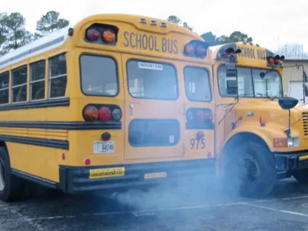
Idling Myth #1
Idling Myth: Warm your bus up for 20-30 minutes before you start your route, so the engine will reach running temperature before you leave the yard.
Idling Fact: Modern diesel engines don’t reach running temperature until driven on the road.
Notes:
Instructors Notes:
Highlight the myth and facilitate a discussion using the points below.
Discussion Points:
Idling Myth number one: Warming your bus up for 20-30 minutes before you start your route, will allow the engine to reach running temperature before you leave the yard.
This is false.
The fact is that modern diesel engines will not reach running temperature until driven on the road for several minutes.

Slide 14
Idling Myth #2
Idling Myth: Idling longer than 5 minutes before starting on your route is better for the engine.
Idling Fact: Excessive idling increases engine wear and wastes fuel.
Notes:
Instructors Notes:
Highlight the myth and facilitate a discussion using the points below.
Discussion Points:
Idling Myth number two, is that idling longer than 5 minutes before starting on your route is beneficial to the engine.
This is false.
Excessive idling, five minutes or more, increases engine wear and wastes fuel.

Slide 15
Idling Myth #3
Idling Myth: Don’t shut your bus off during athletic events or field trips far from home in case it won’t start.
Idling Fact: A well-maintained modern bus will start every time.
If a bus doesn’t start every time, it should be repaired.
Notes:
Instructors Notes:
Highlight the myth and facilitate a discussion using the points below.
Discussion Points:
Idling Myth number three, It is recommended that you don’t shut your bus off during athletic events or field trips far from home in case it won’t start.
This is False.
In fact, a well-maintained modern bus will start every time, and if a bus doesn’t start every time, it should be repaired.

Slide 16
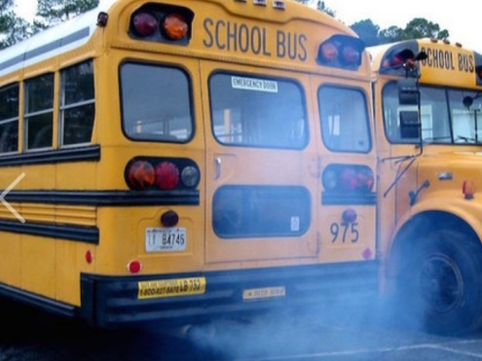
Idling Myth #4
Idling Myth: People who worry about diesel exhaust are tree-huggers who like to complain.
Idling Fact: Diesel exhaust is harmful! Excessive exposure to diesel exhaust is a valid health concern for children, bus drivers, teachers, and other school staff.
Notes:
Instructors Notes:
Highlight the myth and facilitate a discussion using the points below.
Discussion Points:
Idling Myth number four.
People who worry about diesel exhaust are nothing more than tree-huggers who like to complain.
This is false.
The fact is that diesel exhaust is harmful and not just a notion of tree hugging advocates.
Excessive exposure to diesel exhaust is a valid health concern for children, bus drivers, teachers, and other school staff.

Slide 17
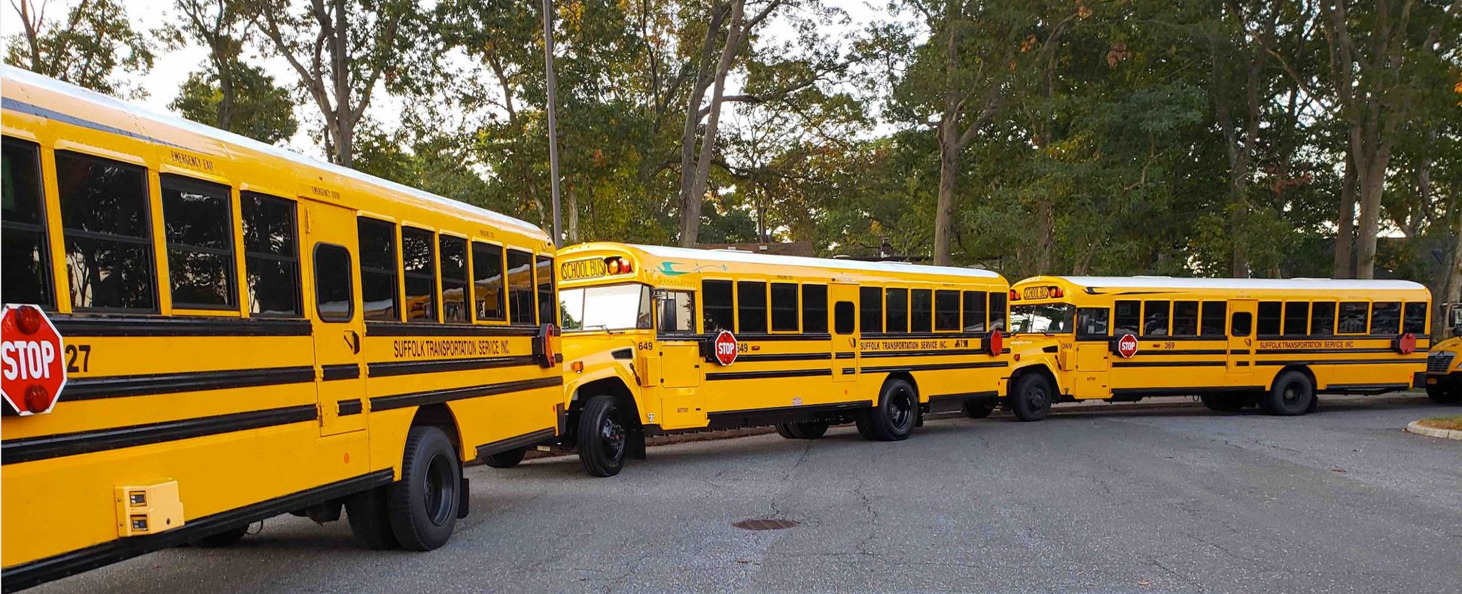
Idling Myth #5
Idling Myth: There’s no way to avoid exposure to diesel exhaust when buses line up in the school loop for afternoon dismissal.
Idling Fact: Bus drivers don’t need to line up so early in the school loop or leave their engines running while waiting for afternoon dismissal to begin.
Notes:
Instructors Notes:
Highlight the myth and facilitate a discussion using the points below.
Discussion Points:
This fifth idling myth is that there’s no way to avoid exposure to diesel exhaust when buses line up in the school loading zone for afternoon dismissal.
This is false.
The fact is that drivers don’t need to line up so early and so close together in the school loading zone or leave their engines running while waiting for afternoon dismissal to begin.

Slide 18
All Efforts Help
The efforts of one and the efforts of many – all help
Becoming knowledgeable makes us all aware
Mandated compliance to a healthier bus ride
Limit idling for all to breath easier
Notes:
Instructors Notes:
Highlight the myth and facilitate a discussion using the points below.
Discussion Points:
As school bus drivers, we must all make the effort to reduce idling.
The more educated we become about the negative effects of excessive idling, the cleaner the air around our buses and school buildings.
The New York State Education Department has mandated us to a healthier school bus ride.
Limit idling on your school bus for all to breathe a little easier.

Slide 19
Thank You For Caring
Notes:
Instructors Notes: Thank you for caring !

